Slide 1
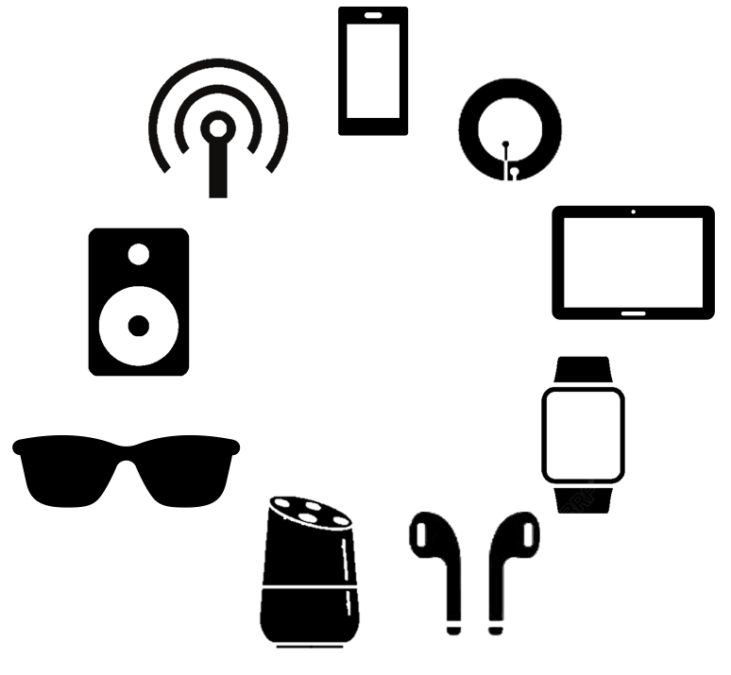


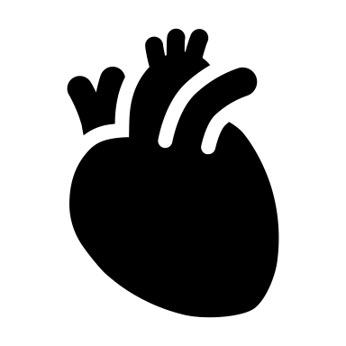
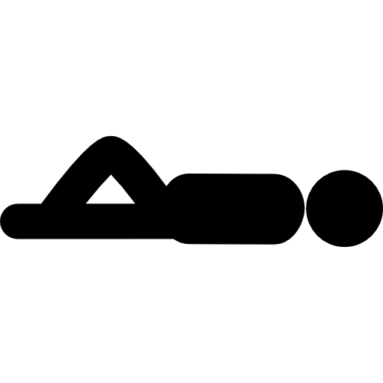

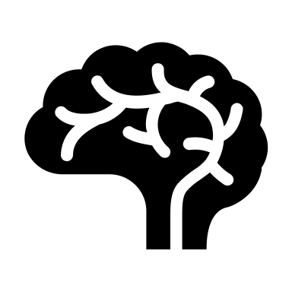
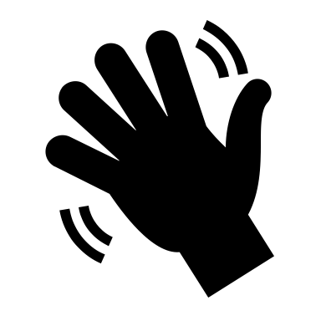

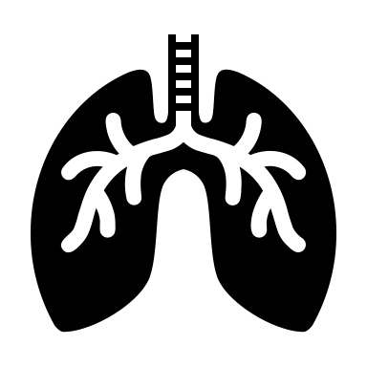
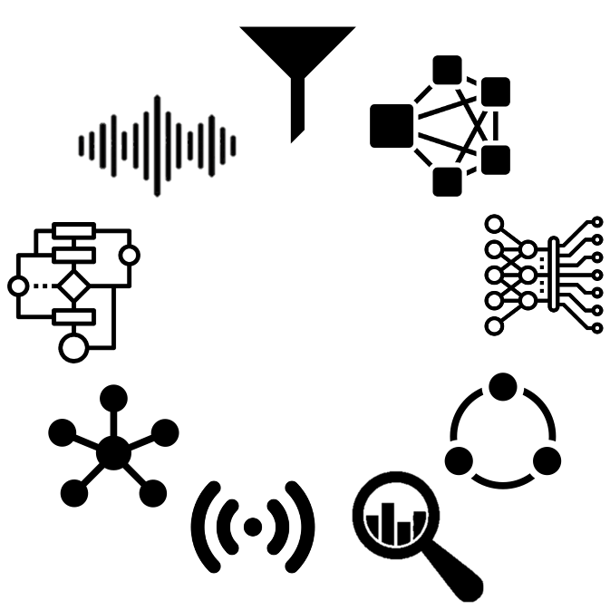
Principles
Applications
Behaviors
IoT
Physical behaviors
Techniques
Physiological behaviors
Notes:
To be more specific, this thesis targets designing new human behaviour-sensing principles based on IoT sensors. Also, since the IoT sensors are much more cost and power-efficient than traditional sensors, as a trade-off, the sensing accuracy shall be compromised. Therefore, proposing new data analytic algorithms to fit the sensory data is another objective. With these tools at hand, various human behaviour-sensing applications can be enabled, including both physical and physiological behaviours.
I narrow down the scope of this thesis into two specific applications. For the physical behaviours, I will focus on designing interaction gesture recognition systems, considering the prevalence of such tasks. For the physiological behaviours, I will focus on analysing pulmonary activities because pulmonary diseases are largely chronic and require long-term management, and this is where cost-efficient IoT devices can help.

Slide 2
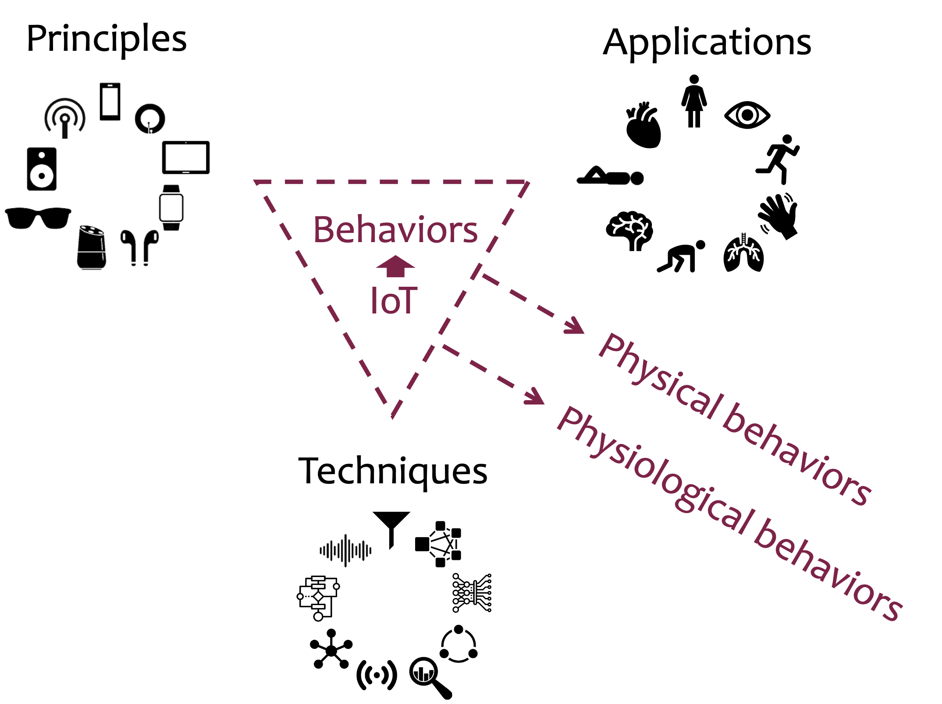

Slide 3
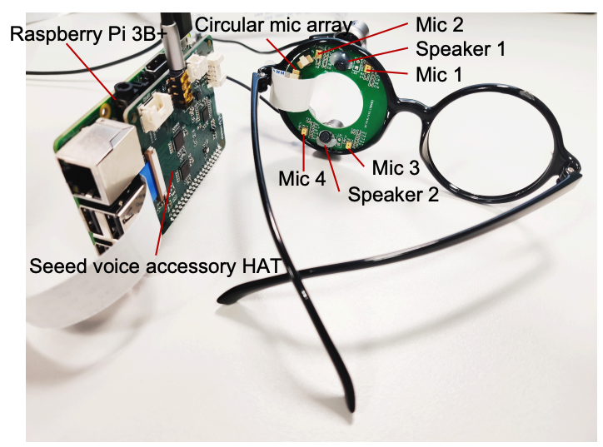

Facial Actions
Facial action sensing with ultrasounds on glasses

Slide 4


Slide 5


Slide 6
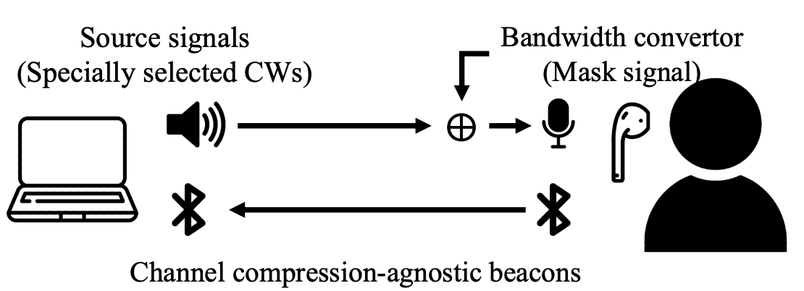
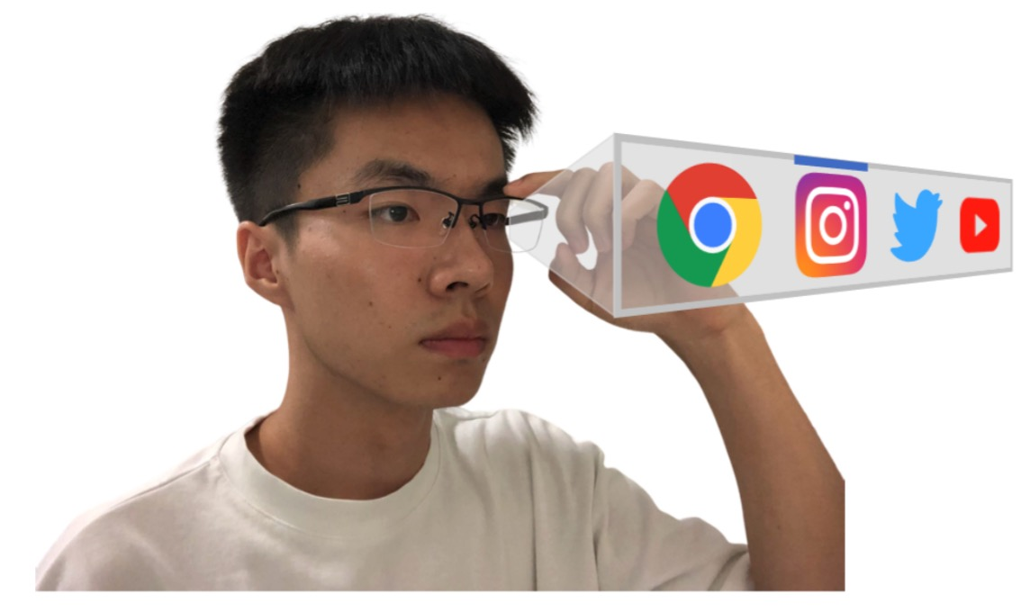

Slide 7
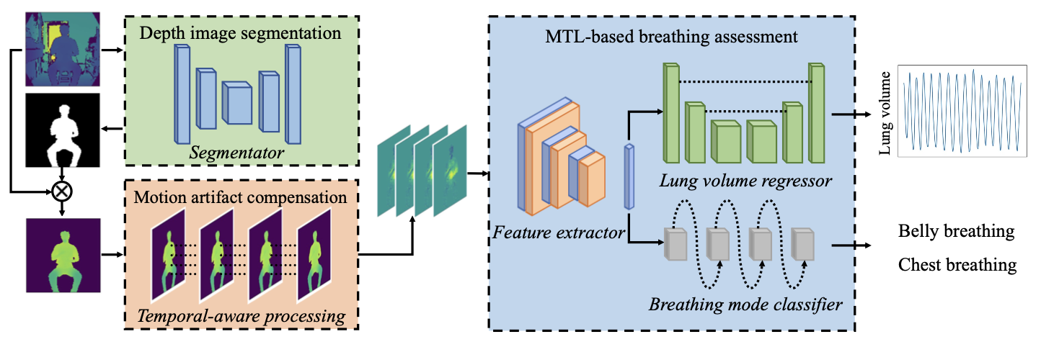
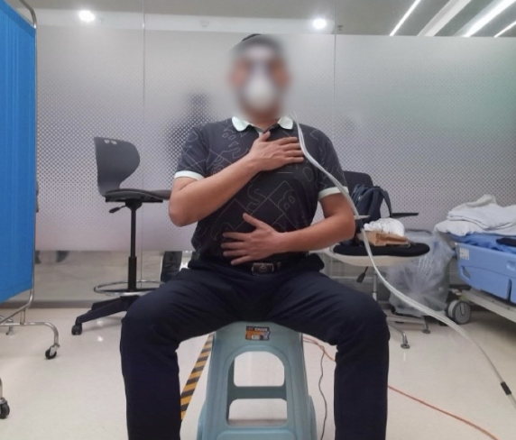
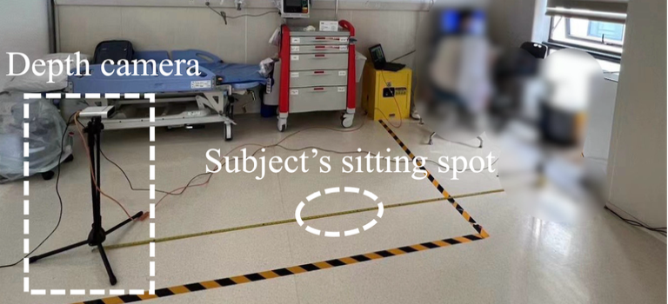
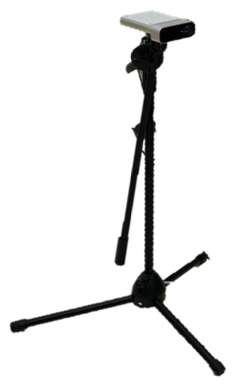

Slide 8
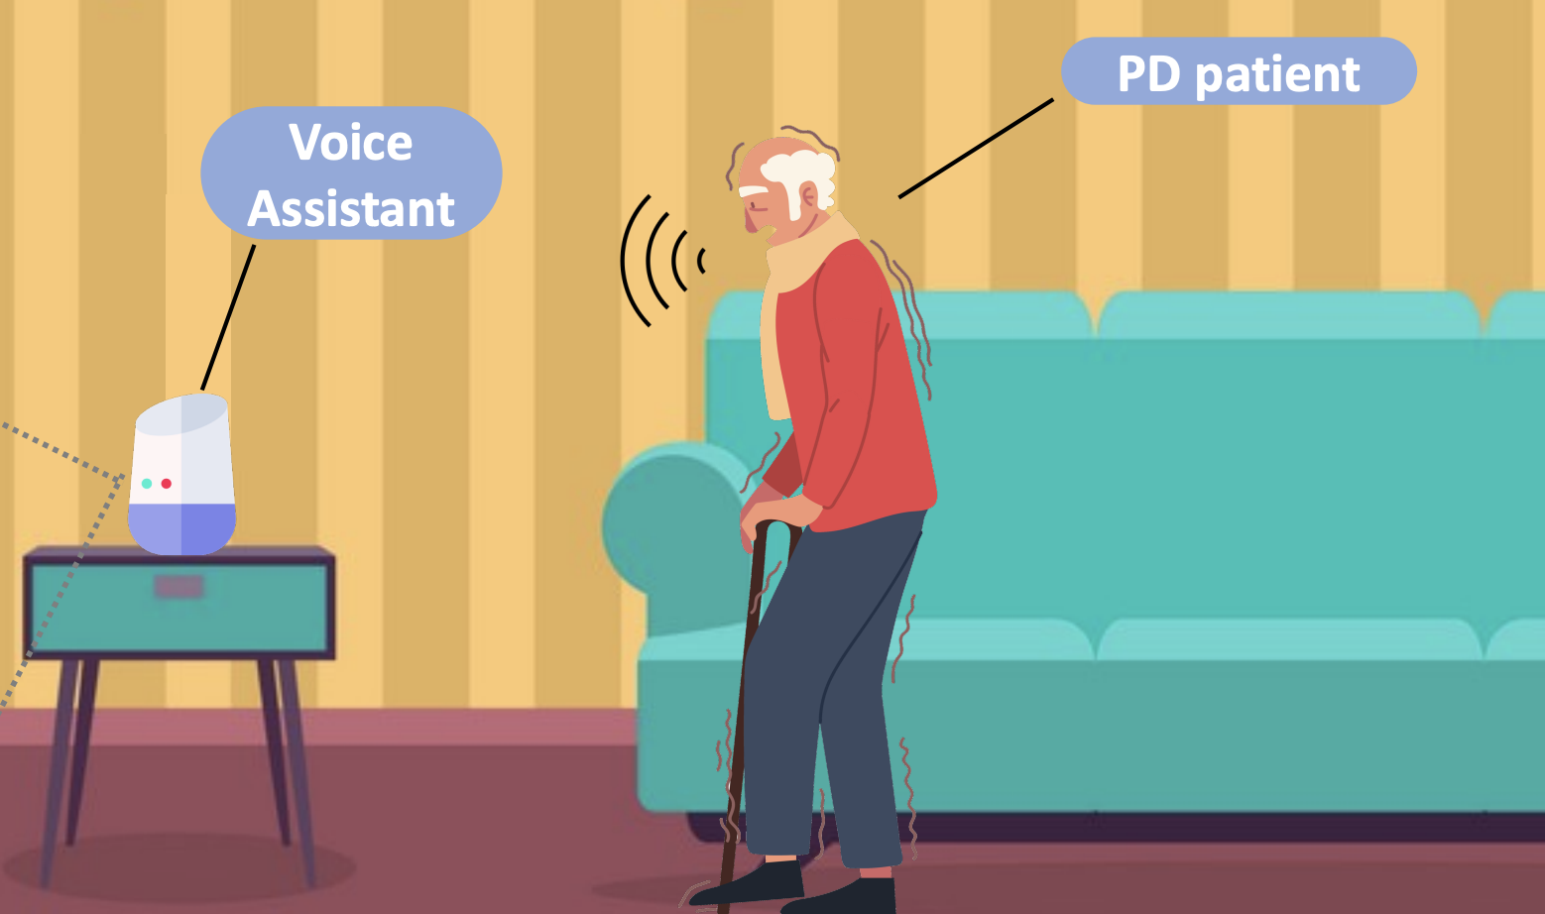

PD severity assessment using free speech recordings

Slide 9
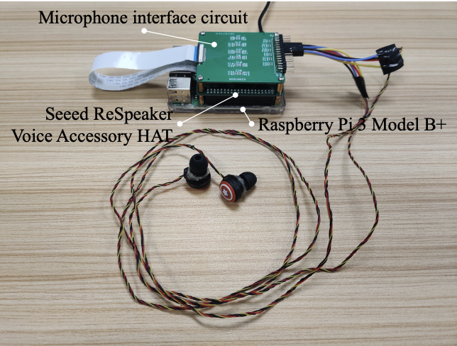
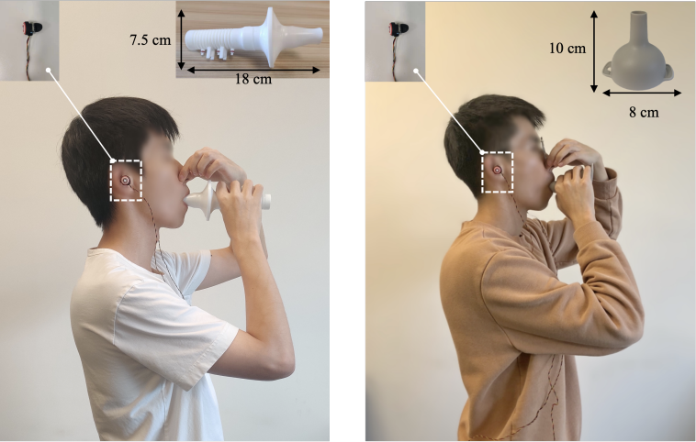
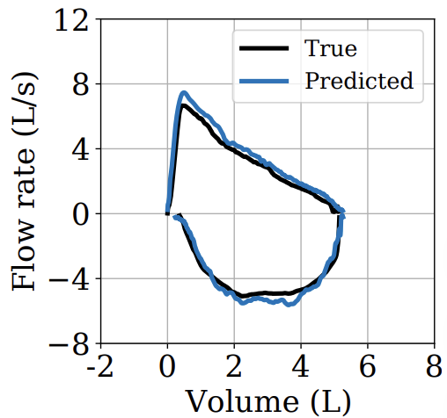

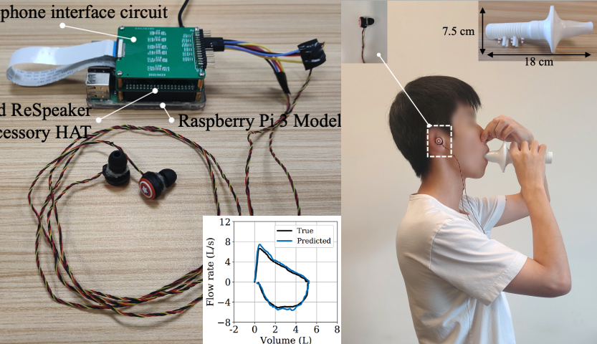
EarSpiro
Lung function assessment using expiration sounds

Slide 10
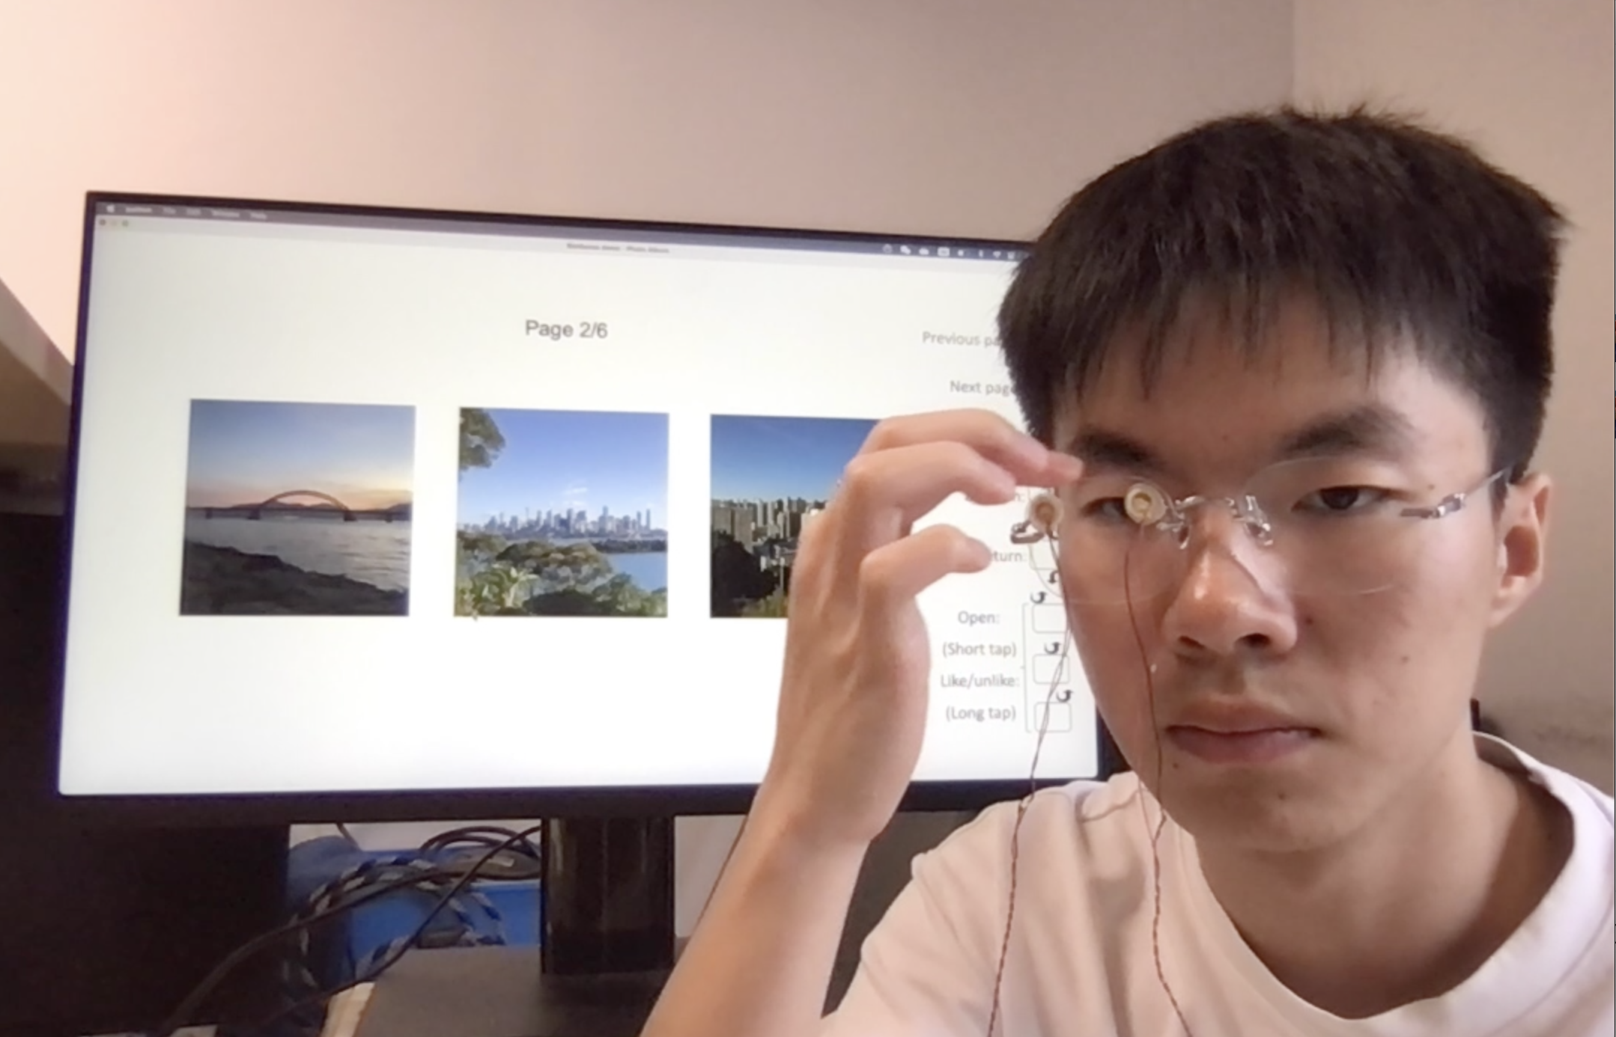


On-glass touch gesture recognition with PZT sensors

Slide 11
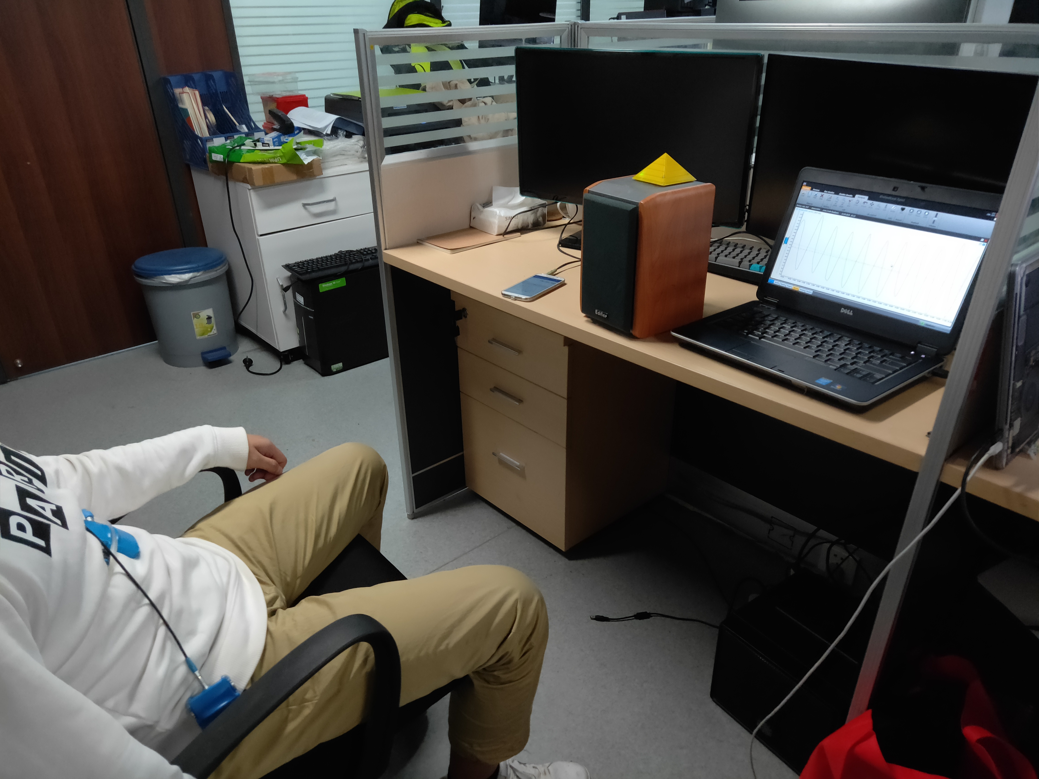


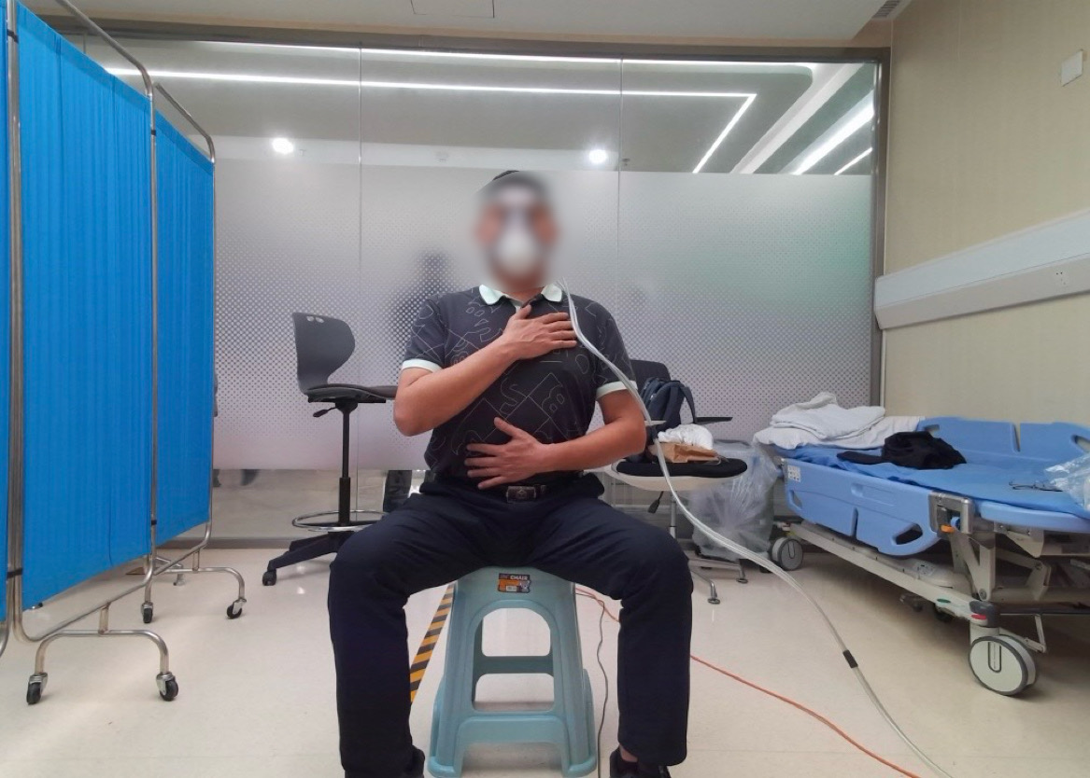

Breathing Detection

Slide 12

DeepBreath

Slide 13
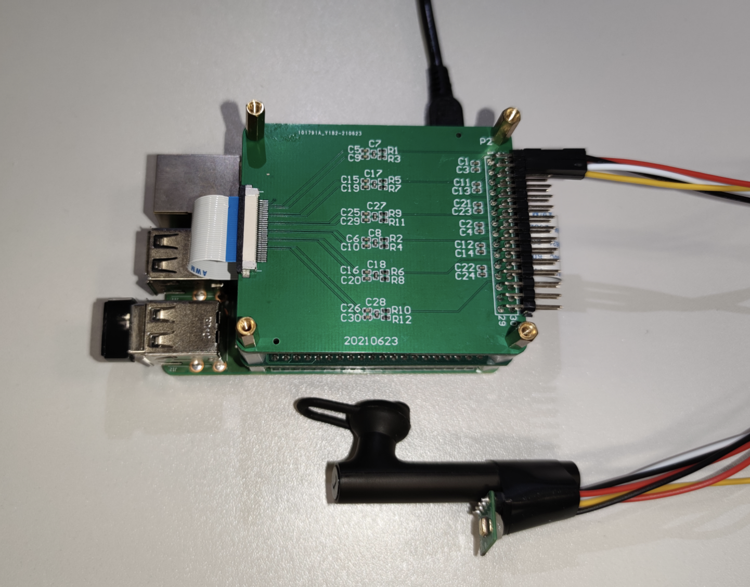


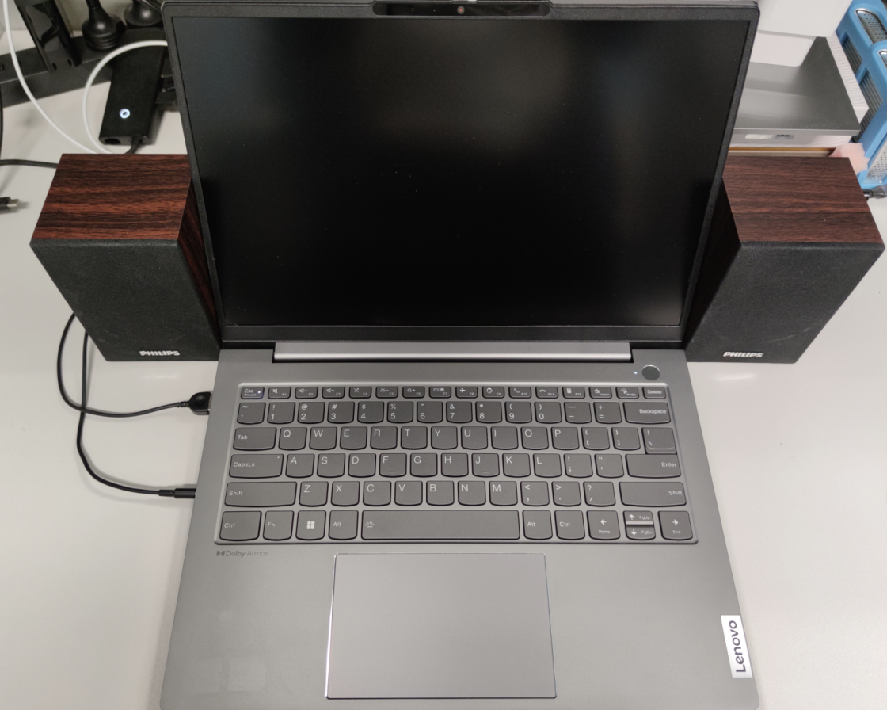
BLEAR
Practical earphone tracking under BLE

Slide 14

Rim touch localization with PZT sensors
Rim Gestures

